Slide 1
EXECUTIVE BRIEFING / Q REVIEW
Car Sales Performance
& Insights
A data-driven view of revenue, pricing and market opportunities across the vehicle sales portfolio.
DATASET
PERIOD
PREPARED FOR
Cleaned vehicle sales
(price, MMR, state, condition, odometer)
2003 – 2015
Chief Executive Officer

Slide 2
EXECUTIVE SUMMARY
What matters most
$8.0B
83.6%
13
8
Total revenue
Revenue from sedans
Model years analysed
Top makes tracked
01
Revenue concentration
Sedans alone drive 83.6% of revenue — a heavy single-segment dependency.
02
Pricing vs MMR gap
Clear gaps versus MMR signal an opportunity to lift margins.
03
Regional outperformance
A handful of states consistently outperform the national baseline.
04
Data quality friction
Duplicates and missing values are eroding reporting accuracy.
05
Upside potential
Diversifying beyond sedans and focusing on top regions unlocks growth.
Car Sales Performance & Insights • Prepared for the CEO
2 / 5

Slide 3
SALES & REVENUE PERFORMANCE
Where the revenue comes from
TOTAL REVENUE
AVG SELLING PRICE
PEAK YEAR
TOP BODY TYPE
$8.0B
$13,611
2012
Sedan
Car Sales Performance & Insights • Prepared for the CEO
3 / 5

Slide 4
PRICING & MARKET INSIGHTS
Selling price vs market value
TOP STATES
California · Florida · Texas
UNDERPERFORMING
Wyoming · Vermont · N. Dakota
Above-MMR vehicles
Margin headroom on cars priced > MMR — protect it.
Significantly overpriced
Tail of listings far above MMR risks slow turnover.
High-value transactions
Concentrated in premium SUV & luxury segments.
Car Sales Performance & Insights • Prepared for the CEO
4 / 5

Slide 5
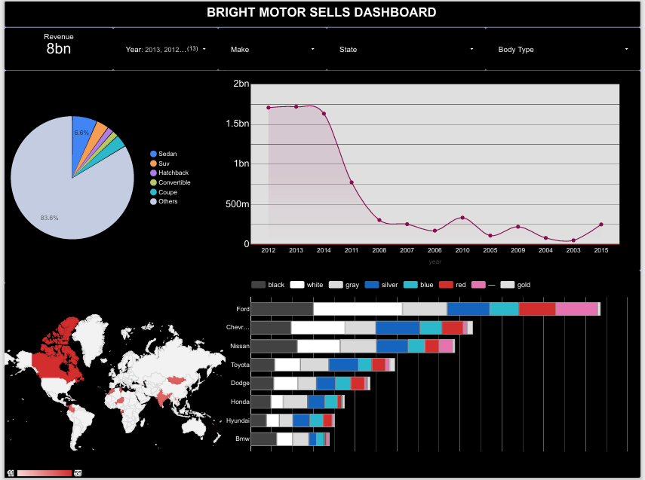

Slide 6
THE WAY FORWARD
Risks, opportunities & recommendations
Risks
Opportunities
Recommendations
Duplicate records distorting reporting
Missing or inconsistent data fields
Pricing inconsistencies across similar vehicles
Double down on high-margin categories
Expand presence in top-performing states
Standardise pricing strategy versus MMR
Prioritise high-performing vehicle segments
Implement pricing controls aligned to MMR
Improve data quality — dedupe & validate
Target growth in top regions
Strong growth potential — unlocked by pricing discipline and regional focus.
5 / 5

